Slide 1
Your Students and the UK Parliament
27 January 2018

Slide 2
Notes:
Irish Dail

Slide 3
Notes:
Northern Ireland Assembly

Slide 4
Notes:
Scottish Parliament

Slide 5
Notes:
Welsh Assembly

Slide 6
Notes:
House of Commons

Slide 7
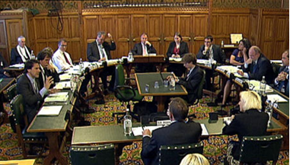
Deliberation vs debate
Select committee:
consensual horseshoe
General committee:
adversarial benches

Slide 8
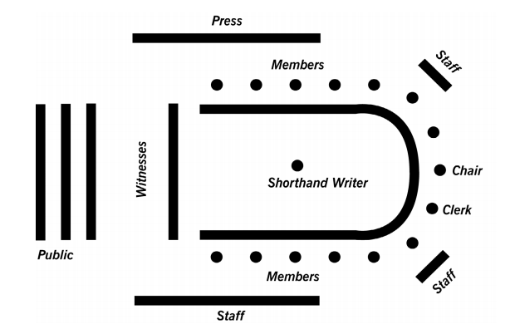

Slide 9
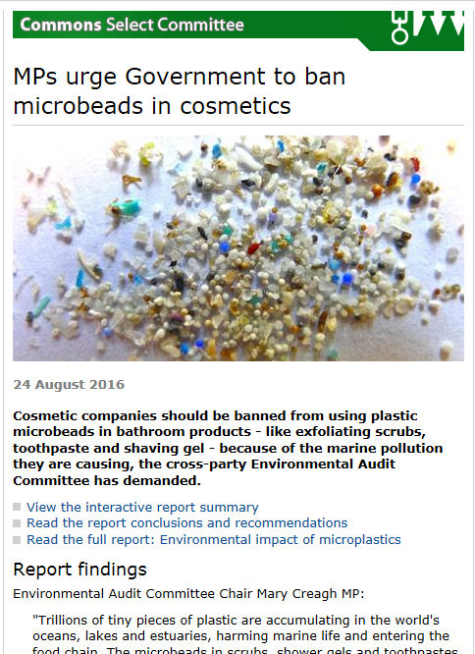
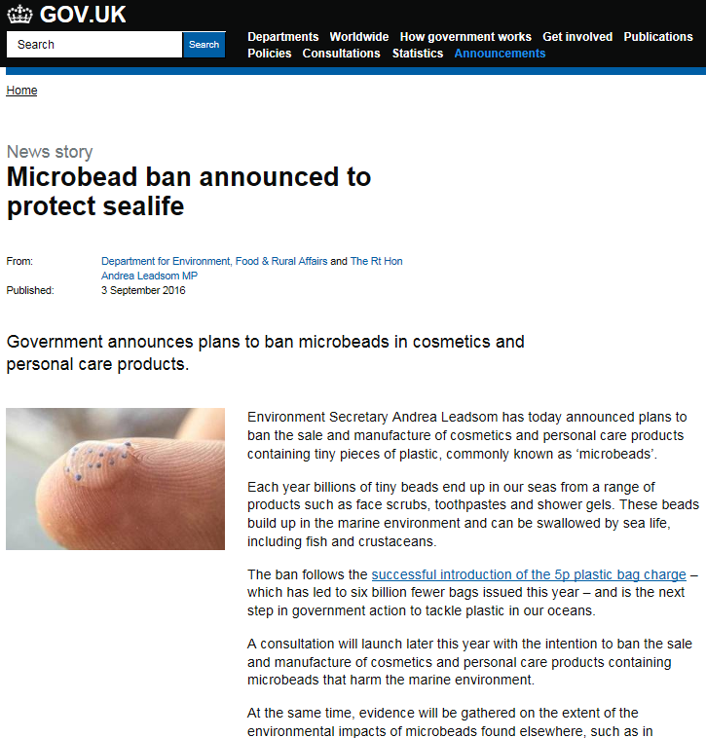

Slide 10
Women & Equalities work to date includes…
Transgender equality
Employment opportunities for Muslims
Gender pay gap
Pregnancy and maternity discrimination
Women in the House of Commons
Equality legislation and the EU exit
Disability and the built environment
High heels and workplace dress codes
Sexual violence and sexual harassment in schools
Sustainable Development Goal 5 in the UK

Slide 11
Notes:
Only way in which the House of Commons parallels other four nations’ seating layout is Select Committees (picture shows UK Youth Select Committee in a Select Committee Room in Portcullis House). In 2017, the UK Youth Select Committee looked into issues surrounding negative body image following a noticeable increase in body confidence issues in the UK. More information and reports can be found at the British Youth Council website http://www.byc.org.uk/uk/youth-select-committee

Slide 12
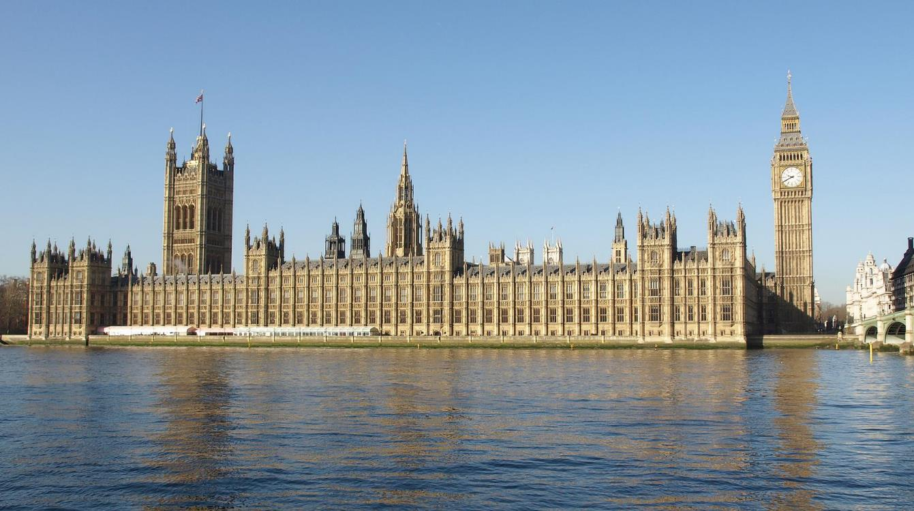
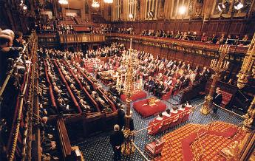
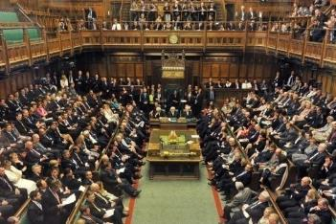
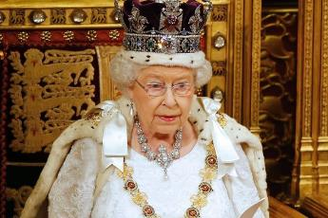
Notes:
This is where laws are made. The Commons can’t make laws on its own. Parliament is made up of three individual parts (not two as many people think): House of Commons; House of Lords; Monarch. All three parts need to agree to any laws that are proposed. Parliament checks (scrutinizes) the work of Government (the executive) to make sure that the laws it proposes are fair and appropriate.

Slide 13
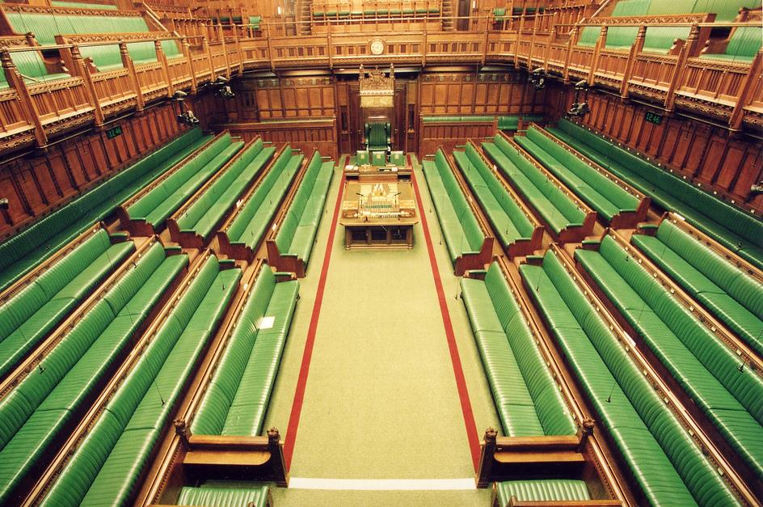
Governing Party
The Official Opposition
317 MPs
262 MPs
35 MPs
Total number of MPs = 650
12 MPs
The Speaker
DUP 10, Sinn Fein 7, PC 4, Green 1, and Independent 1
Notes:
There are 650 MPs in the UK. There are about 70,000 voters in each constituency. You can check the details for your constituency here http://www.parliament.uk/mps-lords-and-offices/mps/
There are boundary changes proposed for 2018. For more information, see http://boundarycommissionforengland.independent.gov.uk/

Slide 14
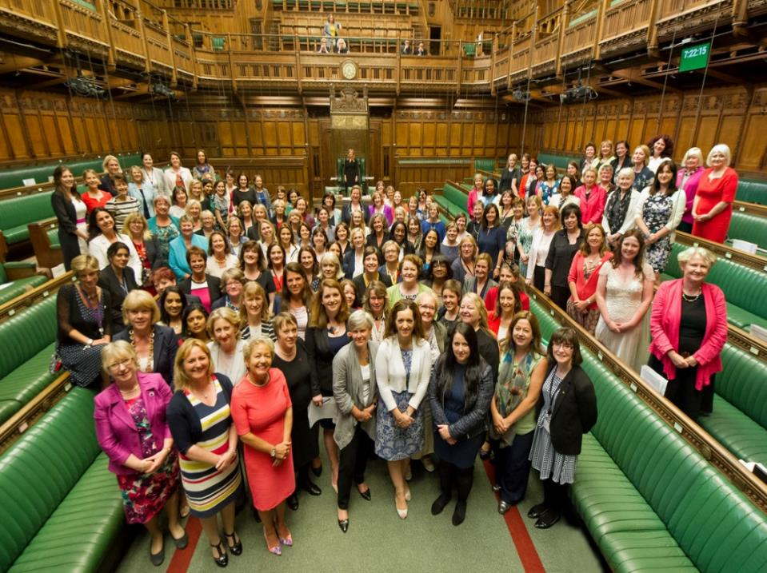
Notes:
191 women were elected to Parliament in May 2015, 29% of the House of Commons (205 women, 26% in the House of Lords). In June 2017, 208 were elected to Parliament, 32% of the House of Commons

Slide 15
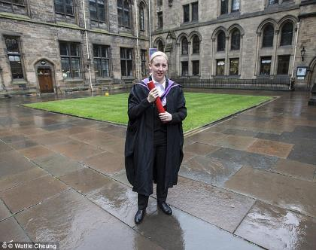
Mhairi Black M.P.
Notes:
You now have to be 18 to stand as an MP (21 until 2010-15 Coalition Govt) Mhairi Black MP won Paisley and Renfrewshire South for the SNP in May 2015 aged 20 and 237 days old. She is the youngest MP since Christopher Monck, 2nd Duke of Albemarle, who was 13 when he was elected as an MP in Devon in 1667.

Slide 16
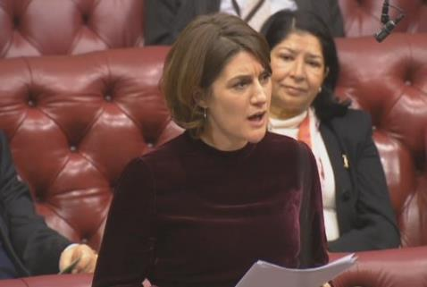
Baroness Bertin
Notes:
The youngest member of the House of Lords is Baroness Bertin, Gabrielle Bertin, born 1978 and formerly Director of Communications to David Cameron 2005 – 16. She is a Member of the House of Lords Communications Committee and also a Trustee of KIDS charity kids.org.uk Lord Wei, born 1977, is the youngest male peer. Nat Wei, the first member of the Chinese community to be appointed to the House of Lords, is also a co-founder of Teach First. Both are Conservative peers.

Slide 17
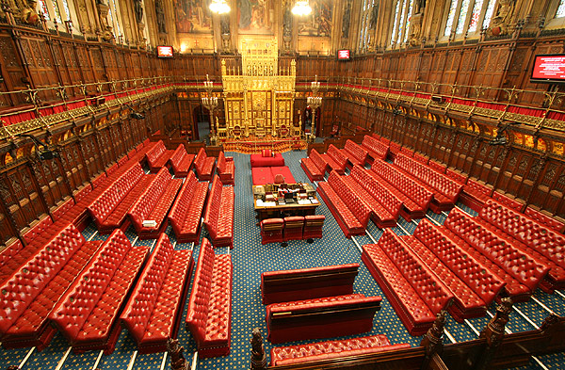
Archbishops/ Bishops 26
Lord Speaker
Official Opposition
210
Governing Party 247
Total current Membership 803
108
Other Parties
39
Cross-Benchers 173
Notes:
Numbers correct as of 22.05.16. Numbers don’t include peers who are on leave of absence. Hereditary peers (92) not identified as separate group as they belong to different parties.

Slide 18
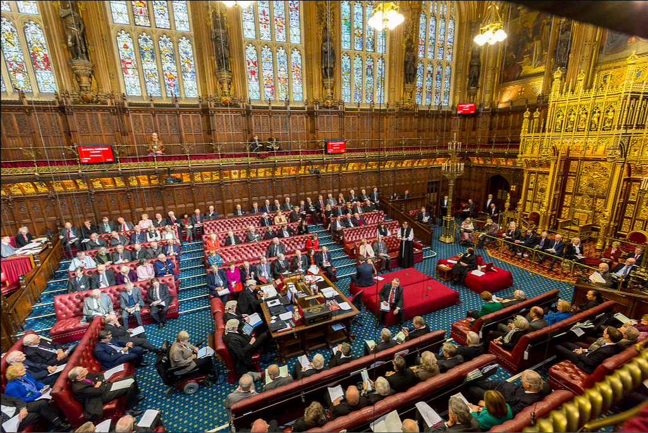

Slide 19
Notes:
Young people aged 11-18 can become a member of the UK Youth Parliament, pictured here in 2014 (the debate was chaired by the Speaker and attended by MPs including William Hague, pictured)

Slide 20
Notes:
The Queen comes to Parliament once a year for State Opening. The last time was 18.05.16 and you can watch the whole ceremony on Youtube https://www.youtube.com/watch?v=ZLJ68StusmA. She’ll next visit Parliament on 19.06.17

Slide 21
803 + 650 + 1 = 1,454
House of Lords
House of Commons
Monarch
Parliament
Notes:
Numbers in both Houses of Parliament (N.B. Numbers in Lords fluctuate)

Slide 22
803 + 650 + 1 = 1,454
House of Lords
House of Commons
Monarch
Parliament
1 + 21 + 96 = 118
Prime Minister
Cabinet
Ministers
Junior Ministers
& Whips
The Government
https://www.gov.uk/government/how-government-works
Notes:
Numbers in Government compared to numbers in Parliament: most of Parliament scrutinises the work of Government i.e. keeps a check on it through questions, debates, committees

Slide 23
Notes:
First meeting of new Cabinet under Theresa May on 19 July 2016

Slide 24
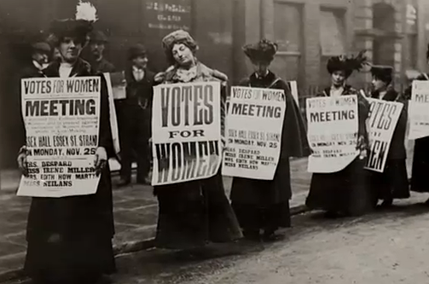
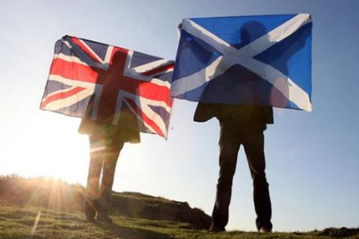
What opportunities can you provide for students to engage with the UK Parliament across the curriculum in school and beyond?
Notes:
Women had to fight long and hard for the right to vote: campaign started in 1856; married women over 30 got the vote in 1918; and didn’t get equal voting rights with men until 1928. During the Scottish referendum in 2014, 16 and 17 year olds were also allowed to vote. How can your students learn more and get involved with active campaigning?

Slide 25
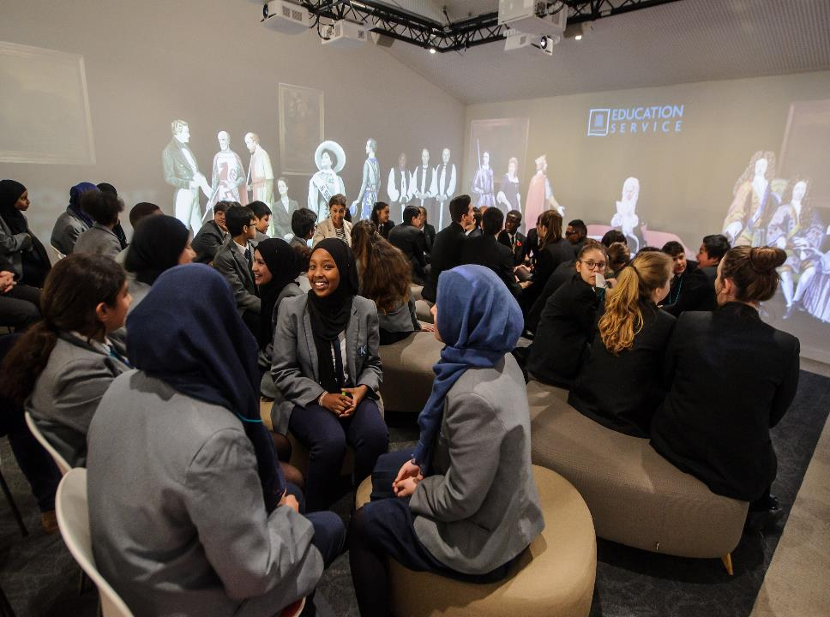
Bring your students to our state-of-the-art Education Centre
Your school may be eligible for a travel subsidy
Notes:
Check whether your school is eligible for a travel subsidy at http://www.parliament.uk/education/visit-parliament-with-your-school/faqs-and-subsidy/transport-subsidy/

Slide 26
Outreach Programme
Click on image icon to get the picture you would like to insert

Slide 27
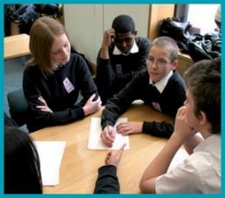
Education Outreach Team
Book a visit from one of our
Outreach Officers
to deliver assemblies and
year group workshops in your
school
E: educationoutreach@parliament.uk

Slide 28
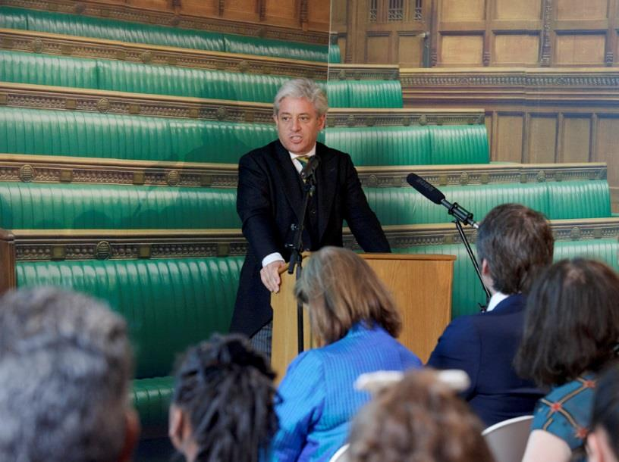
Skype the Speaker
Schools can apply to take part in a live Q&A with the Speaker, Rt Hon John Bercow MP.
educationoutreach@parliament.uk

Slide 29
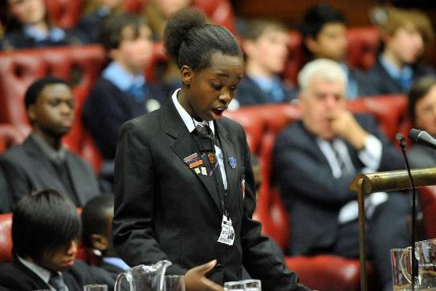
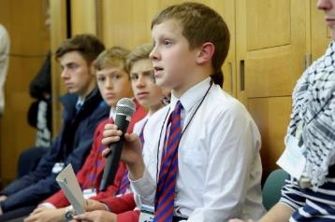
Notes:
The UKYP hold debates in both Houses of Parliament. The Youth Select Committee (YSC – aged 11-18) hold inquiries into e.g. mental health among young people, racism and religious discrimination. For more information, visit the British Youth Council’s website www.byc.org.uk

Slide 30
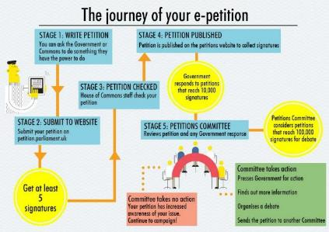
Petitions
Notes:
If there is a local issue of concern to your students, think about launching a petition or e-petition. For more information, visit http://www.parliament.uk/get-involved/sign-a-petition/

Slide 32
Lucy Gavaghan

Slide 33
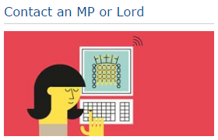
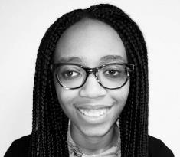
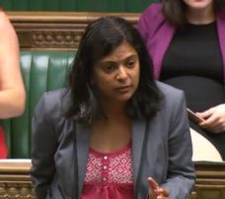
17 year old June Eric-Udorie reached out to her MP in Ealing, Rupa Huq, who decided to back her e-Petition
This led to a government U-turn after the Department of Education made plans to axe all mentions of sex and gender in the proposed Politics A-Level syllabus
Notes:
http://www.independent.co.uk/news/education/education-news/june-eric-udorie-feminism-to-be-taught-in-a-level-politics-curriculum-after-teenagers-campaign-a6804161.html
http://www.telegraph.co.uk/women/life/feminism-will-now-be-compulsory-on-a-level-politics-syllabus/

Slide 34
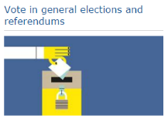
Labour MP Emma Dent Coad won the Kensington seat by 20 votes
Scottish National Party MP Stephen Gethins won the North East Fife seat by 2 votes

Slide 35
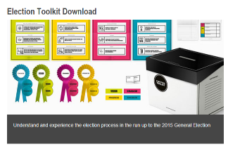
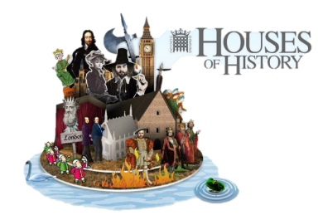
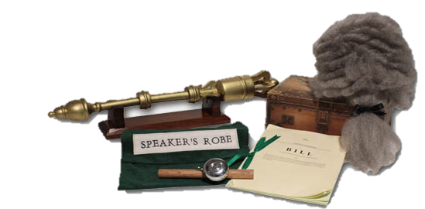
Notes:
www.parliament.uk/education To order class sets of resources, email: requests@edcoms.co.uk

Slide 36
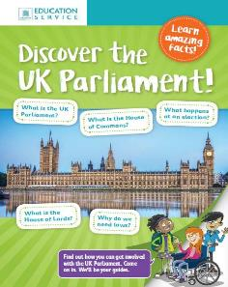
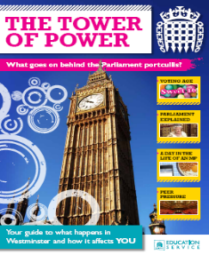
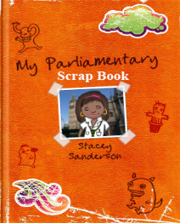
Click on image icon to get the picture you would like to insert
Notes:
www.parliament.uk/education To order class sets of resources, email: requests@edcoms.co.uk

Slide 37
Seminar Days for 2018
Held in Parliament for up to 40 delegates:
13 February – General Seminar Day
13 June – Specialist Seminar Day
(All travel costs are reimbursed for attendees and accommodation can be paid for where necessary, according to our terms and conditions)
Notes:
Think about possible CPD for yourself: in Parliament, we run free one-day seminars each term and run three-day residential courses twice a year (all travel and accommodation costs covered).
Check website for further details and booking forms.

Slide 38
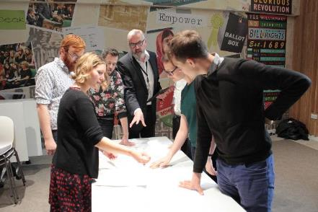
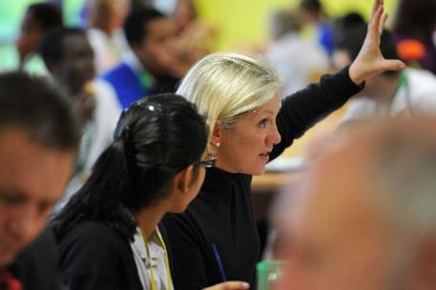
Teachers Institute
22 – 24 January 2018
2 – 4 July 2018
Applications for July 2018 close on 9 April
teachertraining@parliament.uk
Notes:
Think about possible CPD for yourself: in Parliament, we run free one-day seminars each term and run three-day residential courses twice a year (all travel and accommodation costs covered).

Slide 39
Sign up for our monthly update with all the latest news about bookings, events, resources and teaching ideas

Slide 40
Questions?
Notes:
Alison Owen, producer of the film Suffragette (and Lily Allen’s mother), in Parliament’s archives, looking at some of the legislation which has affected women over the years.

Slide 41
www.parliament.uk/education
E: teachertraining@parliament.uk
T: 020 7219 4496
@UKParlEducation

