Slide 1
Citizenship & Identities:
political identity
14th Five Nations Network Conference
Supported by

Slide 2
Liz Moorse & Deepa Shah
Association for Citizenship Teaching (ACT)
Welcome and orientation
Twitter conference hashtag: #5NN
Notes:
Welcome to this fourteenth Five nations network conference and a very special welcome if this is your first time attending.
My name is Liz and I am ACT’s senior manager and this is my colleague Deepa and it’s our job to manage the Five Nations network.
We are delighted that Gordon Cook Foundation have agreed to continue to fund the Five Nations network for a further three years. We are still looking for further funding but are very pleased we have security to continue our work for the medium term.
We are also pleased that Five Nations Network has now been recognised as a Council of Europe Regional Network of the Education for Democratic Citizenship and Human Rights Education programme. Our thanks to Aidan Clifford and David Kerr for their efforts in helping to make this happen.
If this is your first experience of the FN network I hope in the next day or so you get to know the network and feel a part of things. And if you need any help or information during you time here, please don’t hesitate to ask myself, Deepa or one of your country leads.

Slide 3
Conference aims
bring together from across the five nations policy makers, practitioners and other stakeholders with an interest in citizenship and values education
discuss and debate citizenship and identities and explore questions about political identity in depth
encourage new thinking and learning about citizenship and identities and promote dialogue across country partnerships
explore the use of different pedagogies including digital technologies as effective teaching tools for teaching citizenship and identities
reflect on the Five Nations Network and its future development
Notes:
This is the first conference of three on the theme of Citizenship and Identities. The strategy group who help to plan the conferences, chose this topic to explore over a longer period and it is a theme that seems incredibly topical at the moment. Almost on a daily basis we see another news story that relates to citizenship and identities – about migration and the right to welfare; whether face veils be worn in court when giving evidence; who can play for the national football team; should young people vote at 16; and of course should Scotland be an independent country?
The conference programme which is on page 4-5 of your pack is designed we hope to allow you to engage with many different perspectives and aspects of the theme, with today being more input drive and tomorrow being more discursive and reflective. And this structure is in response to comments received at from participants at last years conference. And I would like to say a special thanks everyone who is contributing to the programme over the next 24 hours, whether as a workshop leader or panel member for your help. Also I would like to thank the Five Nations Strategy Group and especially the country leads for Scotland Cathy and Alan for their work in helping to shape the programme for this conference.

Slide 4
Citizenship and Identities: Political Identity
How can we define identities and political identity?
Role of citizenship education
Some challenges for citizenship teaching
Notes:
So now I just want to do three things quite quickly to help set the scene for our conference on ‘Political Identity’ and hopefully to help you get started with your lunchtime discussions.
First to say something about identity and political identity and to offer some definition of what we are talking about
Second to say something about the role of citizenship education in teaching identity
Third to highlight some of challenges this raises for citizenship teaching.

Slide 5
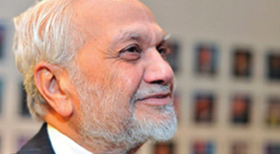
How can we define identities and political identity?
Defined identities as:
Personal – our unique and distinct characteristics
Social – roles & members of groups (father, sister; ethnic, religious, national etc)
Human – universal; membership of the human species
in a globalized world.
‘A New Politics of Identity’ (2008)
Lord Bhikhu Parekh
Notes:
Having done some research and talking with others about the topic of Identity I have found the work of Bhikhu Parekh very helpful. In his book the ‘A new politics of identity’ he provides a very coherent discussion and asks what do we mean by identity, is it a concept and if it is, how can it be conceptualized. He offers a fairly simple definition at three levels of personal, social and human identity.
First, Personal Identity he defines as understanding human beings as distinct and unique. It’s what makes us one person, rather than another, including our characteristics, beliefs and values which are shaped by our experiences in life. In this there are many different planned and unplanned influences including family, school, culture, class, religion. And he says Personal Identity is never a finished product as we encounter new things and gain new insights.
Second, social Identity, the most complex and arguably the most important identity, involving our different roles and relationships as a father, mother, brother, sister, Christian, Indian, black, white etc. and this identity leads to different forms of social belonging.
Parekh says we have more than one social identity, that it is multiple but that we need to go beyond simply acknowledging this and explore how we order and prioritise identities to understand ourselves and each other better.
He says not all social identities are equal; some are sources of our world-view and relate to matters of great concern to us. For example, for religious people, religion is the centre of life and the ultimate source of commitment and their guiding principles.
Third, Human Identity he defines as a universal identity based on the fact we are all human beings, but that it is more than a biological fact but is a morally significant feature and involves considering how to live a good life.
Human identity is mediated through our social identities. For example, we are not simply citizens of the world and we are not simply ‘national’ citizens but we are both. And this becomes apparent for example, when our fellow humans are suffering in war or from hunger or there is some other form of humanitarian crisis where the nation-state has let it citizens down and humans in the spirit of solidarity respond to help.
He also argues that in a multicultural and globalised society it is in the political community where people can find common ground by agreeing the values and principles used to solve problems and live together in a democracy. And so now to discuss political identity.

Slide 6
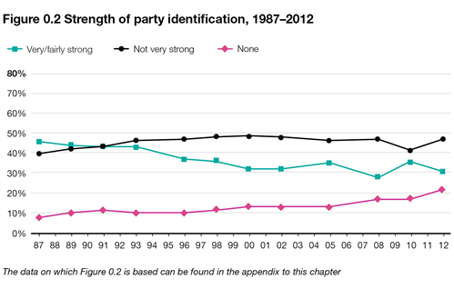
Social attitudes survey 2013: political engagement
Notes:
So what is political identity?
I have struggled to find what I feel is a good definition of political identity. It is often discussed in terms of national identity or party identification and how people vote.
And if we take party identification as an indicator (as measured in the 2013 British Social Attitudes survey) there has been a clear decline in the last 25 years when from 1987 when almost 50% of the population in Britain said they had a strong attachment to a political party, falling to 30% in 2012; and those indicating they have no attachment to a political party rising from 8% in 1987 to 22% in 2012.
But I think we might want to look at a broader and more inclusive definition than one based simply on voting and party identification. I think we need definition that relates to the role and purpose of citizenship education and the extent to which we become active citizens and part of political and democratic life in all sorts of different ways.

Slide 7
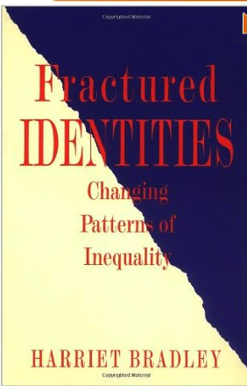
Political Identity?
Three levels
Passive identities in the form of lived relationships (class, gender, ethnicity), but not acted on
Active – conscious identities that come to the fore when threatened eg racism
Politicized – a more constant base for actions and how individuals identify themselves
Notes:
I recently heard a head teacher talking about the work of Harriet Bradley a Sociologist based at the University of Bristol, who wrote a book ‘Fractured Identities. Changing patterns of inequalities’.
She talks about Identity as both a social construct and a set of lived relationships, that need to be understood and explored in the context of dynamic and changing societies.
Bradley set out three levels of identity which she calls passive, active and politicized identity. Everything seems to come in threes!
1. Passive identities – she says are political identities that we have, but which are not acted on. For example, she says class is a passive identity for many people and they do not think of themselves by class unless specifically asked to do so.
2. Active identities – are identities that individuals are conscious of and which sometimes provide a basis for their actions. But often this is in defence against the action of others or when an individual is being defined in a negative way such as when experiencing discrimination eg racism.
3. Politicized identities – she says provide a more constant base for action and where individuals constantly think of themselves in terms of an identity. Politicized identities are formed through political action and provide a basis for collective action. For example, where people have organised themselves to fight for the rights of particular groups or a cause eg gay rights.
Perhaps then there is a wider application of Bradley’s work in the context of citizenship education.

Slide 8
Role of citizenship in developing political identity?
gives young people a sense that they have a stake in society and democracy
learning to be ‘political’, skills and experience of being actively involved in democracy
learning about eg the relationship between citizens and the state, how democracy works
= a need to explore, understand, negotiate their identities
Notes:
So what is the Role of Citizenship in identity education?
Each jurisdiction (England, Ireland, Northern Ireland, Wales and Scotland) has a distinct approach to citizenship education in their national curriculum, but all include something explicit on identity at an individual and social level albeit using different language.
As important as learning about identity (knowledge and understanding) is that each curriculum encourages learning how to operate in the political community, and developing skills to participate in society and democracy as active citizens. So in this sense, citizenship education has a dual and direct role in developing young people’s ‘political’ or ‘politicized identities’.

Slide 9
Some challenges
Develop conceptual understanding of identities
Create space for critical reflection and deeper learning
Help young people understand they ‘belong’ to a political community and it is worth being involved in public and democratic life.
Notes:
Some challenges for citizenship
Some years ago (and before my time) ACT commissioned a review of teaching resources on identity and diversity and it is a bit out of date now but I think it raises some useful issues and challenges for citizenship teaching that relate to both Parekh and Bradley’s work.
These include:
The need to get beyond the personal and help learners conceptualize identity at a social and human level and to understand the multiple and complex nature of identities and how this affects our view of the world and our actions
Ensure there is space to learn about and discuss the difficult stuff and explore the deeper identity based questions e.g.
Why do some people feel excluded and marginalized or that they are treated as second rate citizens?
Where does national identity come from?
Does it matter if some people have a negative view of their country?
Why do some people feel patriotic and others do not?
Should the government promote a particular kind of ‘national’ identity?
And finally, I think a challenge for citizenship education is to provide space to help young people experience belonging to and participating in a political community and that it is worth being involved in democracy even when this means learning to solve difficult problems, to negotiate and compromise and that not everyone gets what they want.
So.
Do you like Parekh conceptualisation of personal, social and human identity?
Does Bradley’s approach to passive, active and politicized identity help explain the role of citizenship in identity education?
And what are the challenges for you?
There is plenty to talk about I think.

